Slide 1

Introduction to Artificial Intelligence
Constraint Satisfaction Problems
Anish Raj

Slide 2
Motivation
One of the major goals of AI is to help humans in solving complex tasks
Assignment Problems:
Who teaches what class?
Timetabling Problems:
Which class is offered when and where?
Transportation Scheduling
Job Scheduling
Factory resource scheduling
Floor Planning

Slide 3

What is Search For?
Assumptions about the world: a single agent, deterministic actions, fully observed state, discrete state space
Planning: sequences of actions
The path to the goal is the important thing
Paths have various costs, depths
Heuristics give problem-specific guidance
Identification: assignments to variables
The goal itself is important, not the path
All paths at the same depth (for some formulations)
CSPs are a specialized class of identification problems

Slide 4

Constraint Satisfaction Problems

Slide 5
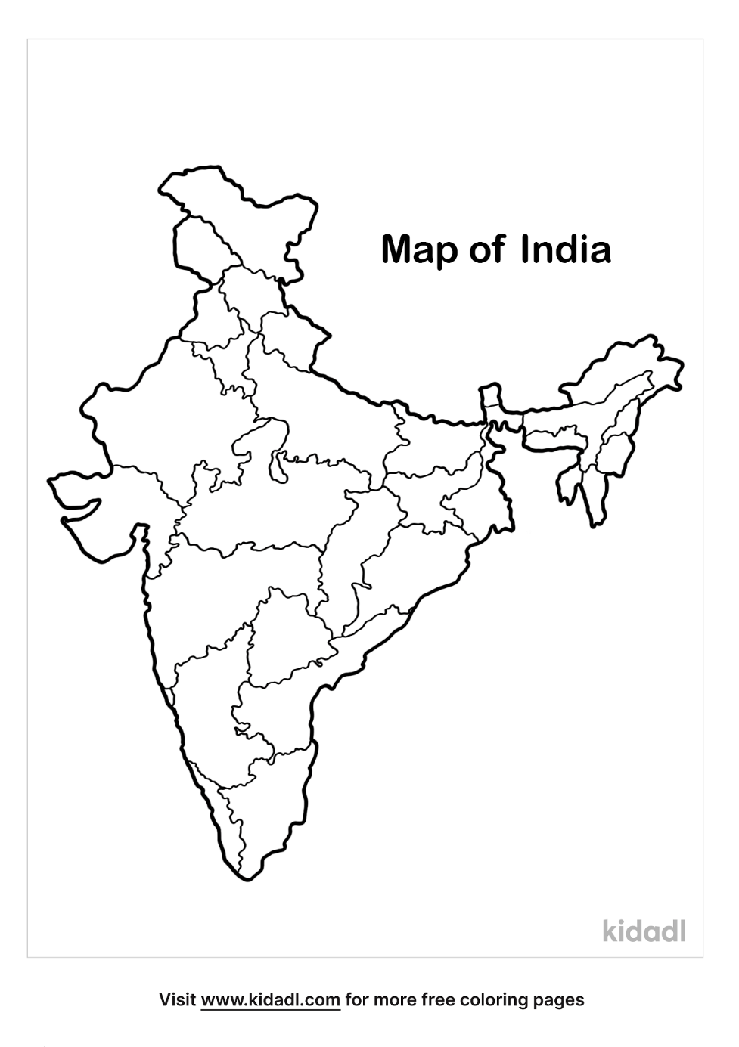
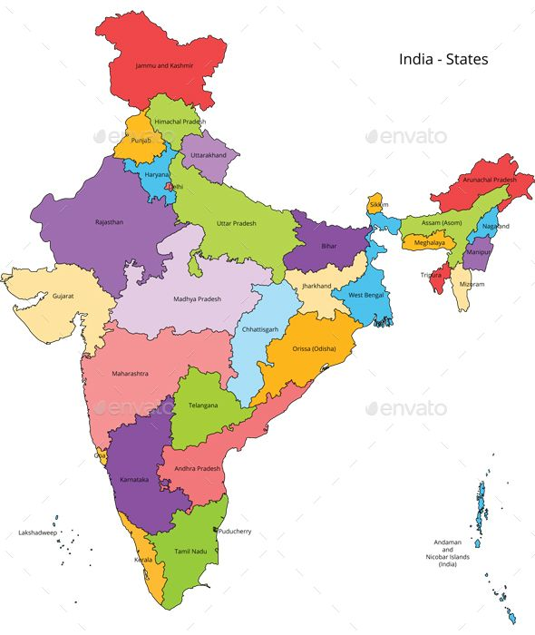

CSP Example

Slide 6

Constraint Satisfaction Problems
Standard search problems:
State is a “black box”: arbitrary data structure
Goal test can be any function over states
Successor function can also be anything
Constraint satisfaction problems (CSPs):
A special subset of search problems
State is defined by variables X_{i} with values from a domain D (sometimes D depends on i)
Goal test is a set of constraints specifying allowable combinations of values for subsets of variables
Allows useful general-purpose algorithms with more power than standard search algorithms

Slide 7
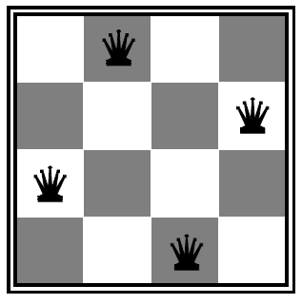




Example: N-Queens

Slide 8



Example: N-Queens
Formulation :
Variables:
Domains:
Constraints:
Implicit:
Explicit:

Slide 9
Example: N-Queens
Formulation :
Variables:
Domains:
Constraints: There are C(4,2) = 6 constraints involved
Constraint Graph

Slide 10
Example: Cryptarithmetic
Notes:
0=7, R=4, W=6, U=2, T=8, F=1; 867 + 867 = 1734

Slide 11
Example: Cryptarithmetic problems
Find numeric substitutions that make an equation hold:
For example:
O = 4
R = 8
W = 3
U = 6
T = 7
F = 1
T W O
+ T W O
= F O U R
7 3 4
+ 7 3 4
= 1 4 6 8
Note: not unique – how many solutions?

Slide 12


Example: Cryptarithmetic
Variables:
Domains:
Constraints:
Notes:
0=7, R=4, W=6, U=2, T=8, F=1; 867 + 867 = 1734

Slide 13
Example: Cryptarithmetic problems
Find numeric substitutions that make an equation hold:
Non-pairwise CSP:
Variables:
Domains:
Constraints:
O+O = R + 10*X₁
X₁ = {0,1}
all-different
F
T
U
W
R
O
W+W+X₁ = U + 10*X₂
X₂ = {0,1}
X₃
X₂
X₁
T+T+X₂ = O + 10*X₃
X₃ = {0,1}
X₃ = F

Slide 14
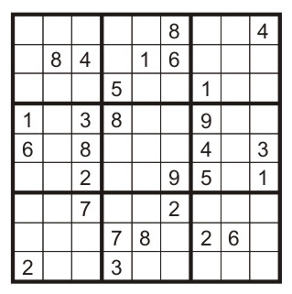
Example: Sudoku
Variables:
Each (open) square
Domains:
{1,2,…,9}
Constraints:
9-way alldiff for each column
9-way alldiff for each row
9-way alldiff for each region
(or can have a bunch of pairwise inequality constraints)

Slide 15
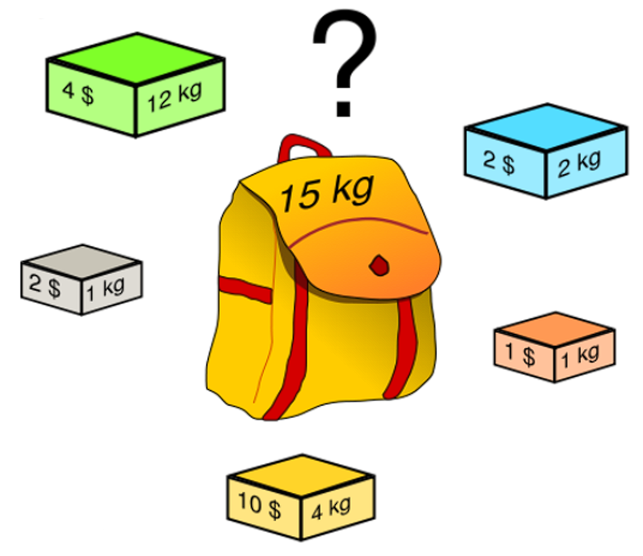
Example: Knapsack Problems
Which items should be put in the bag to maximize the profit
Domain: { G, B, R, Y, P }
Variable: { 0, …, 9 }
Constraint:
12 G + 2 B + 1 R + 4 Y + 1 P <= 15
Find second constraint

Slide 16
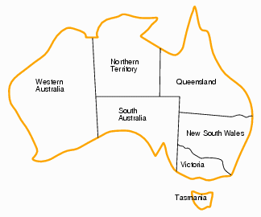
CSP Examples

Slide 17
CSP Examples

Slide 18


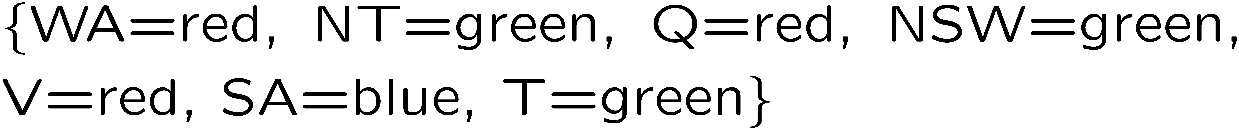
Example: Map Coloring
Variables:
Domains:
Constraints: adjacent regions must have different colors
Solutions are assignments satisfying all constraints, e.g.:
Implicit:
Explicit:

Slide 19
Constraint Graphs

Slide 20
Constraint Graphs
Binary CSP: each constraint relates (at most) two variables
Binary constraint graph: nodes are variables, arcs show constraints
General-purpose CSP algorithms use the graph structure to speed up search. E.g., Tasmania is an independent subproblem!
Notes:
Demo:
Run constraint.jar or constraint.exe, load the 5 queens problem.
Demo is just showing the n-queens applet as illustration of constraint graph, but later in lecture we’ll interact with the applet.
aispace.org will have the latest version

Slide 21
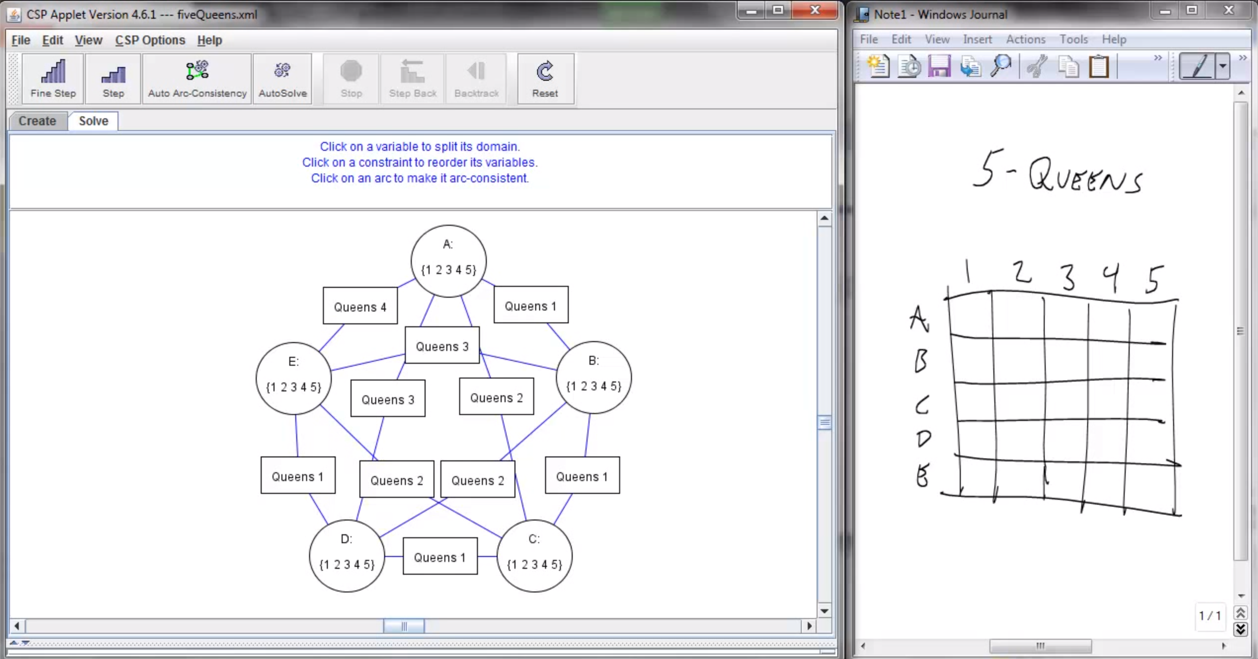
Screenshot of Demo N-Queens
Notes:
Note: the n-queens demo is used later as a demo; at this stage in lecture just the above is shown and talked about without engaging in any interaction with the applet.

Slide 22

Varieties of CSPs and Constraints

Slide 23

Varieties of CSPs
Discrete Variables
Finite domains
Size d means O(d^{n}) complete assignments
E.g., Boolean CSPs, including Boolean satisfiability (NP-complete)
Infinite domains (integers, strings, etc.)
E.g., job scheduling, variables are start/end times for each job
Linear constraints solvable, nonlinear undecidable
Continuous variables
E.g., start/end times for Hubble Telescope observations
Linear constraints solvable in polynomial time by LP methods (see cs170 for a bit of this theory)

Slide 24


Varieties of Constraints
Varieties of Constraints
Unary constraints involve a single variable (equivalent to reducing domains), e.g.:
Binary constraints involve pairs of variables, e.g.:
Higher-order constraints involve 3 or more variables:
e.g., cryptarithmetic column constraints
Preferences (soft constraints):
E.g., red is better than green
Often representable by a cost for each variable assignment
Gives constrained optimization problems
(We’ll ignore these until we get to Bayes’ nets)

Slide 25
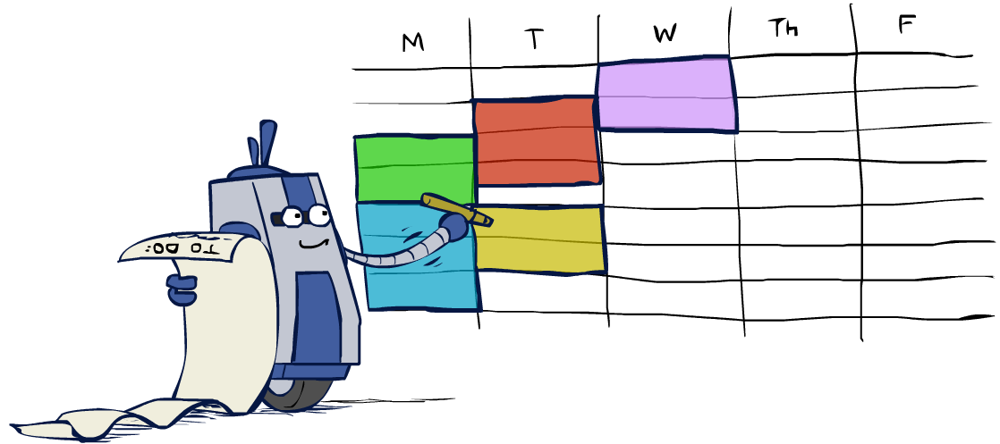
Real-World CSPs
Scheduling problems: e.g., when can we all meet?
Timetabling problems: e.g., which class is offered when and where?
Assignment problems: e.g., who teaches what class
Hardware configuration
Transportation scheduling
Factory scheduling
Circuit layout
Fault diagnosis
… lots more!
Many real-world problems involve real-valued variables…

Slide 26

Solving CSPs

Slide 27
Standard Search Formulation
Standard search formulation of CSPs
States defined by the values assigned so far (partial assignments)
Initial state: the empty assignment, {}
Successor function: assign a value to an unassigned variable
Goal test: the current assignment is complete and satisfies all constraints
We’ll start with the straightforward, naïve approach, then improve it

Slide 28
Search Methods
What would BFS do?
What would DFS do?
What problems does naïve search have?
Notes:
Demo:
CS188 javascript demos -> source -> exercises -> csps -> CSPs demos -> CSPs demos.html
Settings:
Graph = Simple
Algorithm = Naïve Search
Ordering = None
Filtering = None

Slide 29

Video of Demo Coloring -- DFS

Slide 30

Backtracking Search

Slide 31
Backtracking Search
Backtracking search is the basic uninformed algorithm for solving CSPs
Idea 1: One variable at a time
Variable assignments are commutative, so fix ordering
I.e., [WA = red then NT = green] same as [NT = green then WA = red]
Only need to consider assignments to a single variable at each step
Idea 2: Check constraints as you go
I.e. consider only values which do not conflict with previous assignments
Might have to do some computation to check the constraints
“Incremental goal test”
Depth-first search with these two improvements
is called backtracking search (not the best name)
Can solve n-queens for n ≈ 25

Slide 32
Video of Demo Coloring – Backtracking

Slide 34
Backtracking Example

Slide 35
Backtracking Search
Backtracking = DFS + variable-ordering + fail-on-violation
What are the choice points?
Notes:
Demo:
CS188 javascript demos -> source -> exercises -> csps -> CSPs demos -> CSPs demos.html
Settings:
Graph = Simple
Algorithm = Backtracking
Ordering = None
Filtering = None

Slide 36

Improving Backtracking
General-purpose ideas give huge gains in speed
Ordering:
Which variable should be assigned next?
In what order should its values be tried?
Filtering: Can we detect inevitable failure early?
Structure: Can we exploit the problem structure?

Slide 37
Improving Backtracking
Before search:
Reduce the search space
Arc-consistency, path-consistency, i-consistency
Variable ordering (fixed)
During search:
Look-ahead schemes:
Detecting failure early; reduce the search space if possible
Which variable should be assigned next?
Which value should we explore first?
Look-back schemes:
Backjumping
Constraint recording
Dependency-directed backtracking

Slide 38

Look-Ahead
Intuition:
Apply propagation at each node in the search tree (reduce future branching)
Choose a variable that will detect failures early (low branching factor)
Choose value least likely to yield a dead-end (find solution early if possible)

Slide 39
Filtering: Forward Checking
Filtering: Keep track of domains for unassigned variables and cross off bad options
Forward checking: Cross off values that violate a constraint when added to the existing assignment
WA
NT
Q
SA
NSW
V
Notes:
Demo:
CS188 javascript demos -> source -> exercises -> csps -> CSPs demos -> CSPs demos.html
Settings:
Graph = Simple
Algorithm = Backtracking
Ordering = None
Filtering = Forward Checking

Slide 40
Video of Demo Coloring – Backtracking with Forward Checking

Slide 41
Filtering: Constraint Propagation
Forward checking propagates information from assigned to unassigned variables, but doesn't provide early detection for all failures:
NT and SA cannot both be blue!
Why didn’t we detect this yet?
Constraint propagation: reason from constraint to constraint
NT
Q
WA
SA
NSW
V

Slide 42

Ordering

Slide 43

Ordering: Minimum Remaining Values
Variable Ordering: Minimum remaining values (MRV):
Choose the variable with the fewest legal left values in its domain
Why min rather than max?
Also called “most constrained variable”
“Fail-fast” ordering

Slide 44
Minimum Remaining Values (MVR)
WT |  |  |  | NT |  |  |  | Q |  |  |  | NSW |  |  |  | V |  |  |  | SA

Slide 45
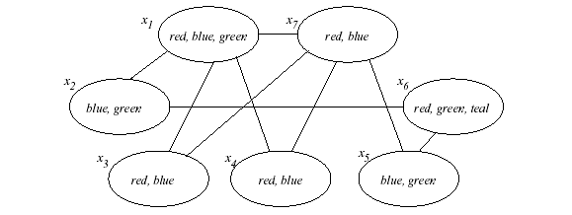
EXAMPLE

Slide 46
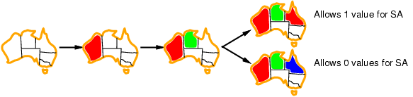

Ordering: Least Constraining Value
Value Ordering: Least Constraining Value
Given a choice of variable, choose the least constraining value
I.e., the one that rules out the fewest values in the remaining variables
Note that it may take some computation to determine this! (E.g., rerunning filtering)
Why least rather than most?
Combining these ordering ideas makes
1000 queens feasible
Notes:
Demo:
CS188 javascript demos -> source -> exercises -> csps -> CSPs demos -> CSPs demos.html
Settings:
Graph = Complex
Algorithm = Backtracking
Ordering = MRV
Filtering = Forward Checking
Solves already without any need for backtracking
Note: need a bigger problem to illustrate relevance of backtracking+AC+MRV+MCV

Slide 47

Consistency of A Single Arc
An arc X → Y is consistent iff for every x in the tail there is some y in the head which could be assigned without violating a constraint
Forward checking: Enforcing consistency of arcs pointing to each new assignment
NT
Q
WA
SA
NSW
V
Delete from the tail!

Slide 48
Arc Consistency of an Entire CSP
A simple form of propagation makes sure all arcs are consistent:
Important: If X loses a value, neighbors of X need to be rechecked!
Arc consistency detects failure earlier than forward checking
Can be run as a preprocessor or after each assignment
What’s the downside of enforcing arc consistency?
NT
Q
WA
SA
NSW
V
Remember: Delete from the tail!

Slide 49
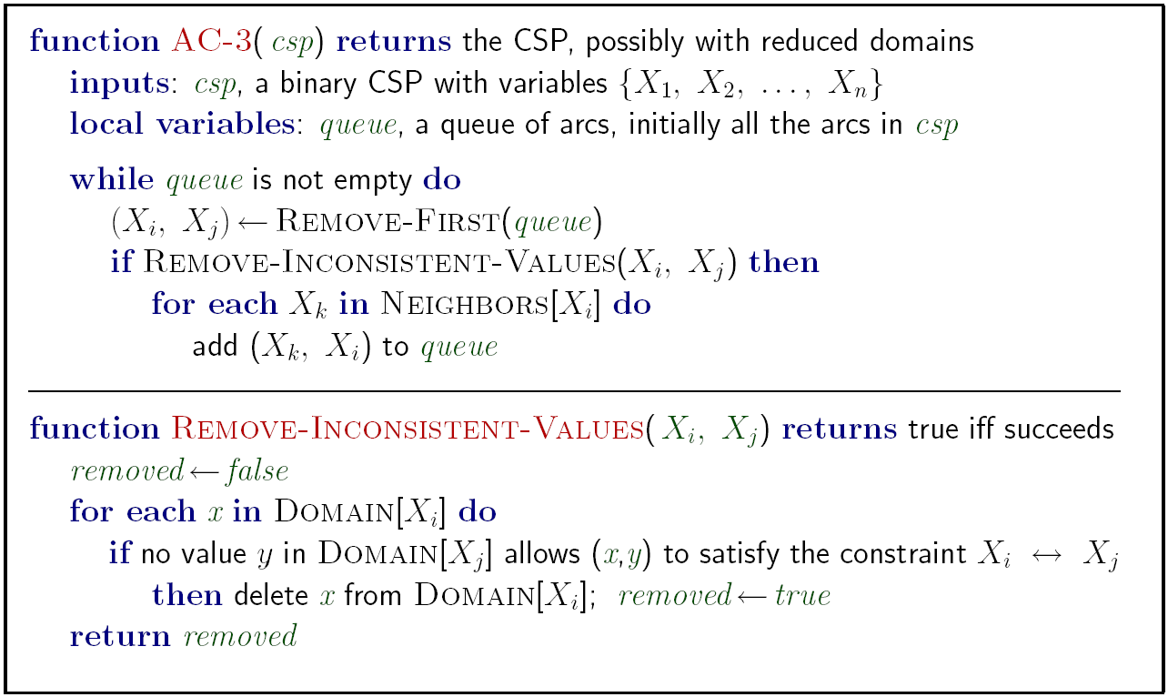
Enforcing Arc Consistency in a CSP
Runtime: O(n²d³), can be reduced to O(n²d²)
… but detecting all possible future problems is NP-hard – why?
Notes:
Auto-consistency (note initially nothing gets deleted/pruned since there are consistent options for all constraints for initial variable domains)
Flashes whenever something needs to be re-checked

Slide 50
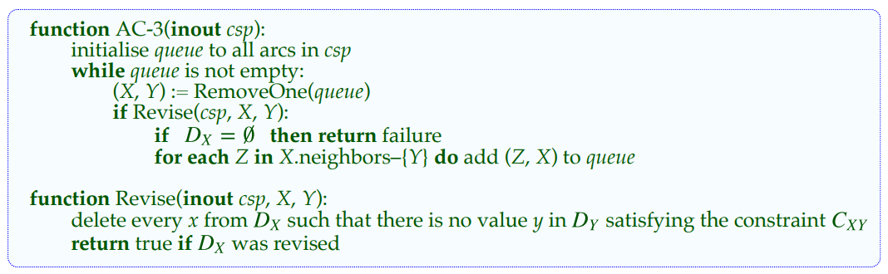
ARC Consistency Algorithm, AC-3
Keep a set of arcs to be considered: pick one arc (X, Y) at the time and make it consistent (i.e., make arc X consistent to Y).
Start with the set of all arcs {(X, Y), (Y, X), (X, Z), (Z, X), …. }.
When an arc has been made arc consistent, does it ever need to be checked again?
An arc (Z, X) needs to be revisited if the domain of X is revised.

Slide 51
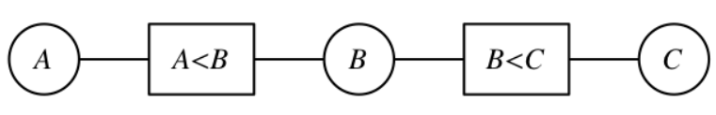
ARC-3 Example - 1
Remove D_{A} D_{B} D_{C} Add Queue___________
1234 1234 1234 A<B, B<C, C>B, B>A
A<B 123 1234 1234 B<C, C>B, B>A
B<C 123 123 1234 A<B C>B, B>A, A<B
C>B 123 123 234 B>A, A<B
B>A 123 23 234 C>B A<B, C>B
A<B 12 23 234 C>B
C>B 12 23 34 ∅

Slide 52
ARC-3 Example
A
C + A = 6
A < B
C
C > B
B

Slide 53
ARC-3 Example - 2
Remove D_{A} D_{B} D_{C} Add Queue___________________________
1234 1234 1234 A<B, B<C, C+A=6, A+C=6, C>B, B>A
A<B 123 1234 1234 C+A=6 B<C, C+A=6, A+C=6, C>B, B>A, C+A=6
B<C 123 123 1234 A<B C+A=6, A+C=6, C>B, B>A, C+A=6, A<B
C+A=6 123 123 34 C>B A+C=6, C>B, B>A, C+A=6, A<B, C>B
A+C=6 23 123 34 B>A C>B, B>A, C+A=6, A<B, C>B, B>A
C>B 23 123 34 B>A, C+A=6, A<B, C>B, B>A
B>A 23 3 34 C>B C+A=6, A<B, C>B, B>A, C>B
C+A=6 23 3 34 A<B, C>B, B>A, C>B
A<B 2 3 34 C+A=6 C>B, B>A, C>B, C+A=6
C>B 2 3 4 A+C=6 B>A, C>B, C+A=6, A+C=6
B>A 2 3 4 C>B, C+A=6, A+C=6

Slide 54
ARC-3 Example
Remove D_{A} D_{B} D_{C} Add Queue_____________________________
1234 1234 1234 A<B, B<C, C+A=6, A+C=6, C>B, B>A
A<B 123 1234 1234 C+A=6 B<C, C+A=6, A+C=6, C>B, B>A, C+A=6
B<C 123 123 1234 A<B C+A=6, A+C=6, C>B, B>A, C+A=6, A<B
C+A=6 123 123 34 C>B A+C=6, C>B, B>A, C+A=6, A<B, C>B
A+C=6 23 123 34 B>A C>B, B>A, C+A=6, A<B, C>B, B>A
C>B 23 123 34 B>A, C+A=6, A<B, C>B, B>A
B>A 23 3 34 C>B C+A=6, A<B, C>B, B>A, C>B
C+A=6 23 3 34 A<B, C>B, B>A, C>B
A<B 2 3 34 C+A=6 C>B, B>A, C>B, C+A=6
C>B 2 3 4 A+C=6 B>A, C>B, C+A=6, A+C=6
B>A 2 3 4 C>B, C+A=6, A+C=6
C>B 2 3 4 C+A=6, A+C=6
C+A=6 2 3 4 A+C=6
A+C=6 2 3 4 ∅

Slide 55
ARC Consistency Algorithm, AC-3

Slide 56
ARC-3 Example - 3
X
Y
<
1,
2,
3
1,
2,
3
1 ≤ X, Y, Z, T ≤ 3
X < Y
Y = Z
T < Z
X ≤ T
∧
=
1,
2,
3
<
1,
2,
3
T
Z

Slide 57
Limitations of Arc Consistency
After enforcing arc consistency:
Can have one solution left
Can have multiple solutions left
Can have no solutions left (and not know it)
Arc consistency still runs inside a backtracking search!
What went wrong here?
Notes:
Demo:
CS188 javascript demos -> source -> exercises -> csps -> CSPs demos -> CSPs demos.html
Settings:
Graph = Complex
Algorithm = Backtracking
Ordering = None
Filtering = Forward Checking (first) / Arc Consistency (second)

Slide 58
Summary
CSPs
special kind of problem: states defined by values of a fixed set of variables, goal test defined by constraints on variable values
Backtracking = depth-first search with one variable assigned per node
Forward checking prevents assignments that guarantee later failure
Heuristics
Variable ordering and value selection heuristics help significantly
Variable ordering (selection) heuristics
Choose variable with Minimum Remaining Values (MRV)
Degree Heuristic – break ties after applying MRV
Value ordering (selection) heuristic
Choose Least Constraining Value
Constraint propagation (e.g. ARC consistency) does additional work to constraint values and detect inconsistencies

